Slide 1

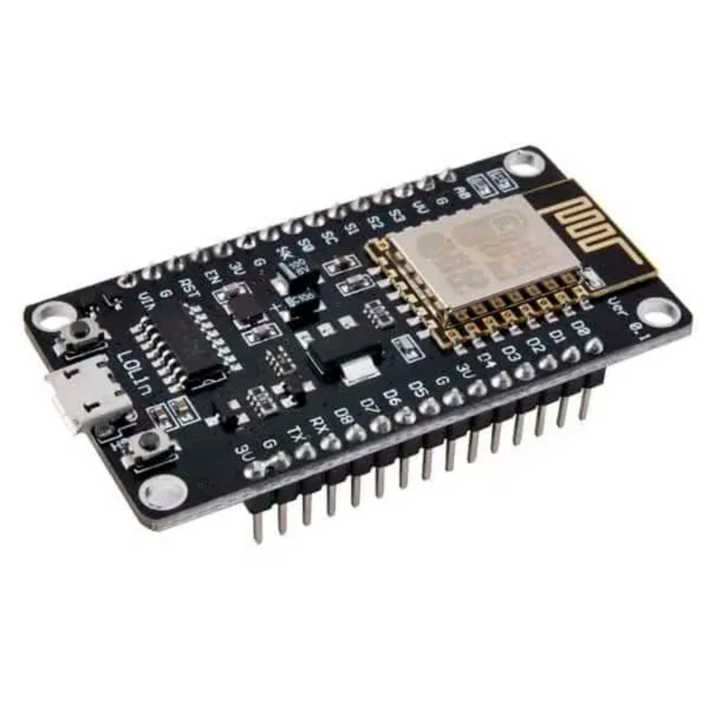
Embark on IoT
A Hands-On Workshop with NodeMCU ESP8266
Learn to build and program your own Internet of Things devices
From basic circuits to cloud-connected projects
Beginner-friendly, hands-on approach
By
Dr. R. S. Rimal Isaac
rimalisaac@gmail.com

Slide 2
Sensors
Analogue/Digital
IoT – Hardware
(Arduino/ESP/
Raspberry)
IoT – Connection Type (WiFi / Bluetooth)

Slide 3


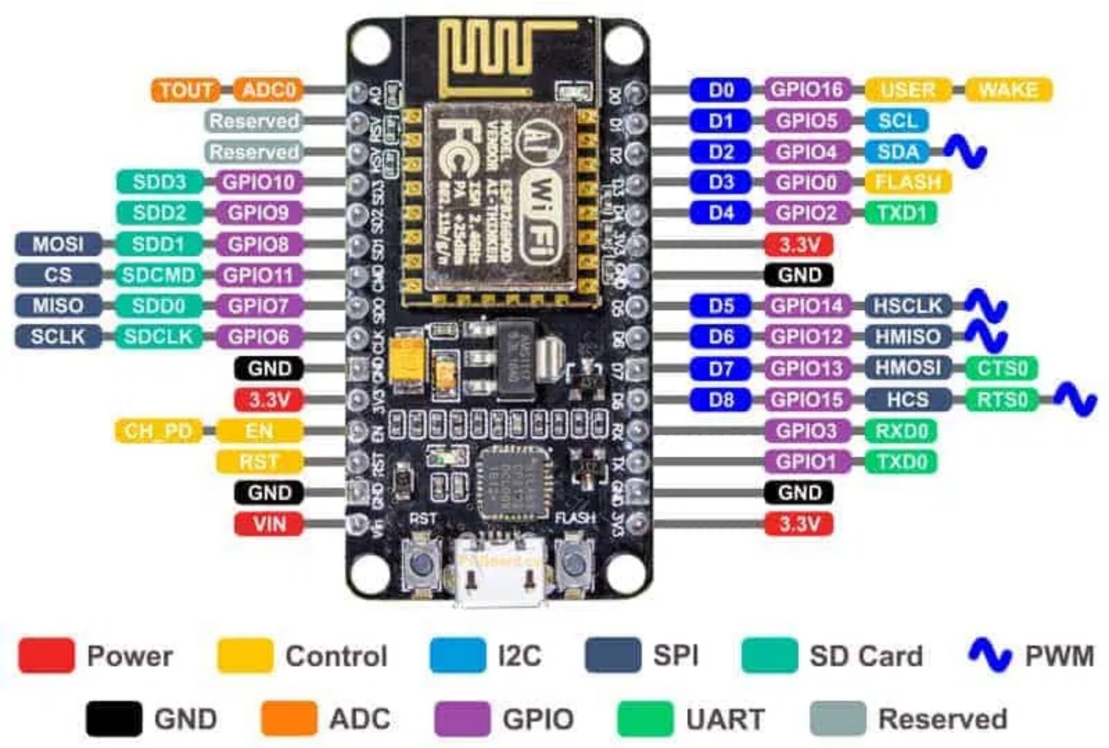

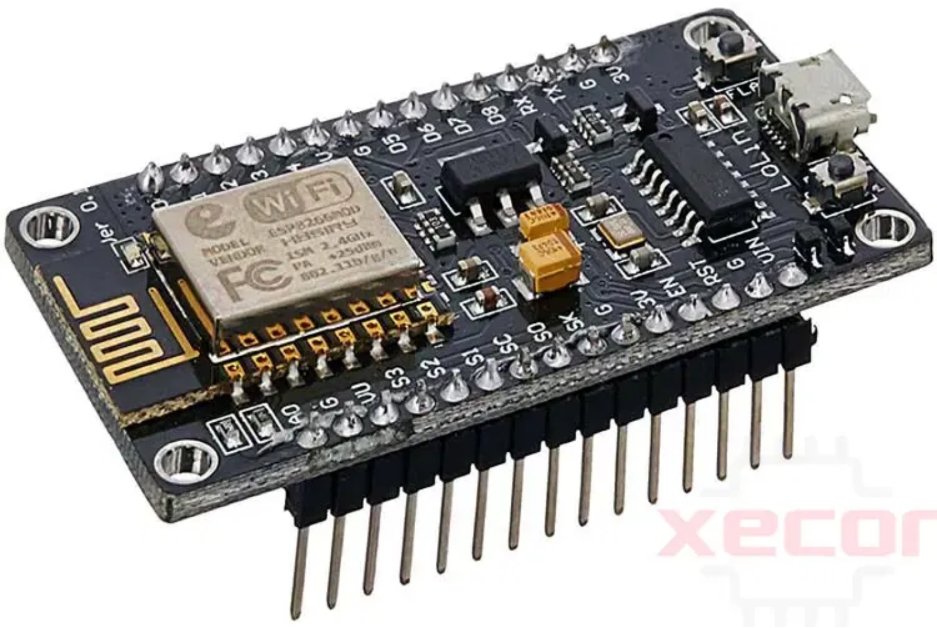

Introduction to ESP8266
What is ESP8266?
Low-cost Wi-Fi microchip with integrated TCP/IP
Built-in microcontroller capabilities
3.3V operating voltage, not 5V tolerant
17 GPIO pins for various functions
Programmable with Arduino IDE
Comparison with Arduino Uno
Built-in Wi-Fi connectivity
Higher processing power (80-160 MHz vs 16 MHz)
More memory (4MB Flash, 80KB RAM)
Lower power consumption
Smaller form factor
Applications in Physics
Remote data acquisition and logging
Wireless sensor networks for experiments
Real-time data visualization
Automated experiment control
Environmental monitoring for labs

Slide 4









Workshop Requirements
Knowledge Prerequisites
Software Requirements
Basic Computer Literacy
Arduino IDE
Familiarity with using a personal computer, managing files, and browsing the internet
Download and install the latest version from the official Arduino website
CH340 Driver
Programming Fundamentals (Recommended)
Required for Windows to detect the NodeMCU board's USB-to-Serial chip
Basic understanding of programming concepts like variables, if-else conditions, and for loops is helpful but not mandatory
ESP8266 Board Support
Add board support for ESP8266 in Arduino IDE
Hardware Requirements
Required Libraries
Various libraries for sensors and displays will be installed during the workshop
A Laptop
With Windows, macOS, or Linux operating system
Important Note:
Administrative Rights
All software requirements should be installed
BEFORE
attending the
Ability to install software and drivers on your laptop
workshop to ensure a smooth experience. Detailed installation
USB-A Port
instructions will be covered in the following slides.
To connect the NodeMCU board (USB-C adapter required if your laptop only has USB-C ports)

Slide 5

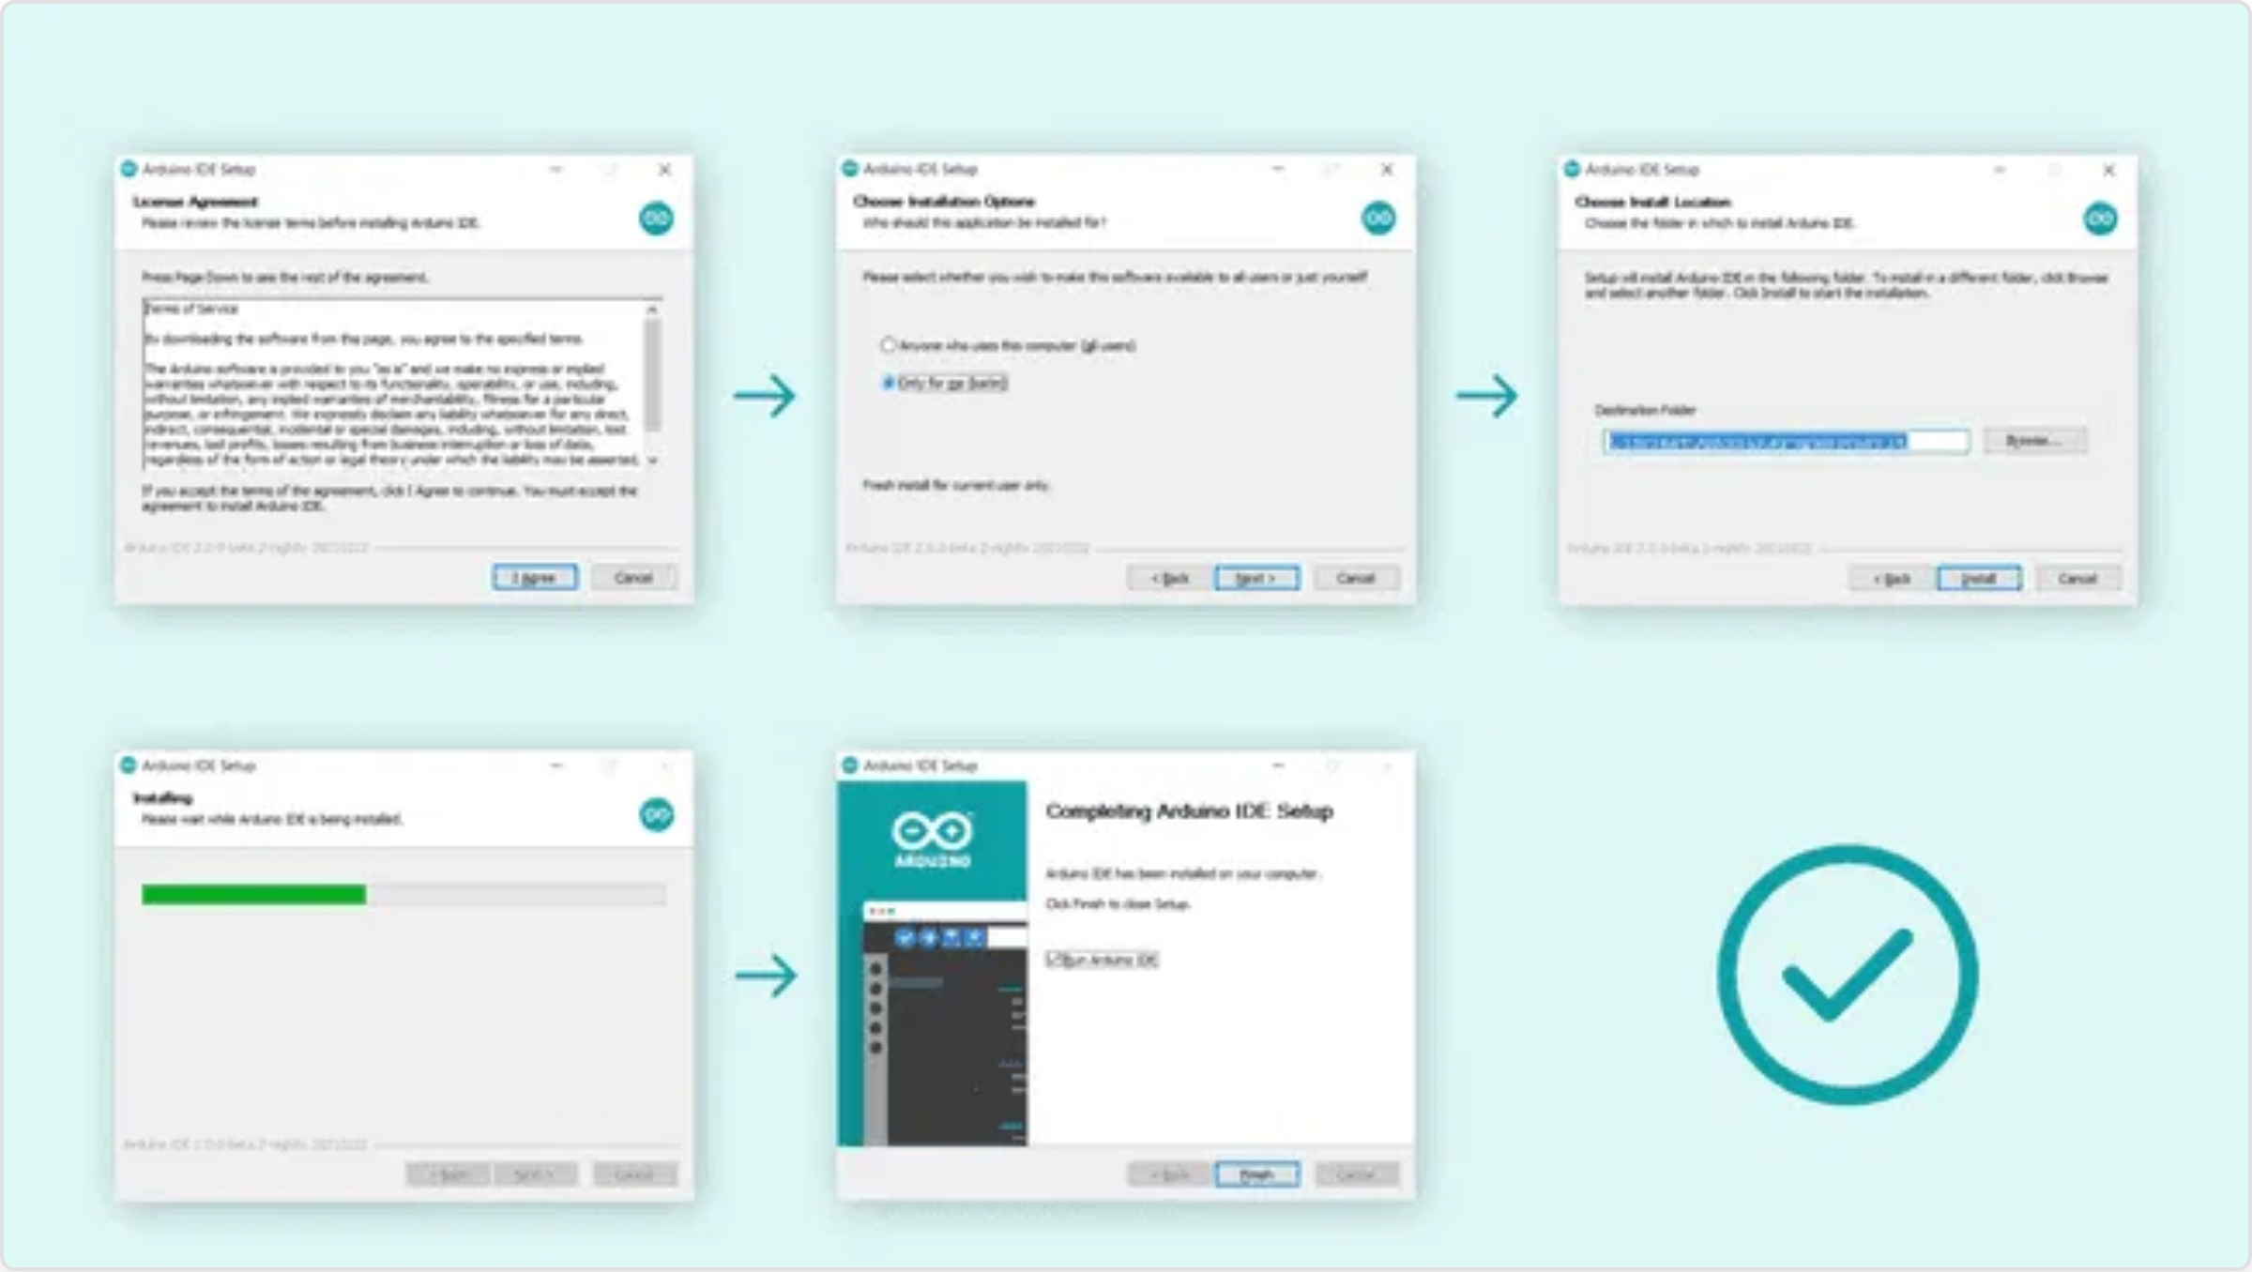
Arduino IDE Installation
Arduino IDE Interface
Installation Steps
1
Download Arduino IDE
Visit the official Arduino website at
arduino.cc/en/software
2
Choose Your Operating System
Select the appropriate version for your OS (Windows, macOS, or Linux)
3
Download and Run the Installer
For Windows: Run the .exe file
For macOS: Drag Arduino to Applications folder
For Linux: Extract the archive and run install.sh
4
Complete the Installation
Follow the on-screen instructions to complete the installation process
Arduino IDE 2.0 Interface
Key Features:
Code Editor:
Write and edit your Arduino sketches
5
Launch Arduino IDE
Verify Button:
Check your code for errors
Open the Arduino IDE from your applications menu or desktop shortcut
Upload Button:
Send your code to the Arduino board
Note:
Serial Monitor:
View output from your Arduino
Arduino IDE 2.x is recommended for this workshop as it offers improved features and performance compared to the 1.x version.
Board Selection:
Choose the correct board type
Port Selection:
Select the USB port your board is connected to

Slide 6

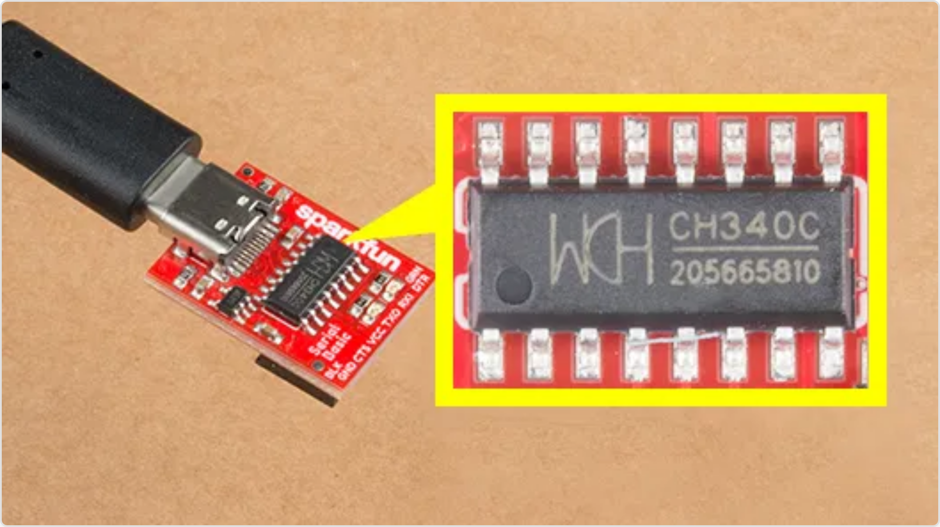
CH340G Driver Installation
What is CH340G?
The CH340G is a USB-to-Serial converter chip used in many NodeMCU boards and Arduino clones. Your computer needs the proper driver to communicate with this chip.
CH340G Chip Identification
Installation Steps
1
Download the Driver
Get the CH340G driver from
2
Install the Driver
Windows:
Run the installer (.exe file)
CH340G Chip on a USB-to-Serial Adapter
macOS:
Open the .dmg file and follow instructions
Why is this important?
Linux:
Usually no installation needed (built-in kernel support)
https://cdn.sparkfun.com/assets/learn_tutorials/5/9/7/Windows-CH340-Driver.zip
Without the CH340G driver, your computer won't recognize the NodeMCU board when connected via USB. This means you won't be able to:
3
Verify Installation
Windows:
Check Device Manager for "USB-SERIAL CH340"
Upload code to the board
macOS:
Check System Report > USB for "wch.cn"
Communicate with the board via Serial Monitor
Linux:
Run
dmesg | grep CH34x
in terminal
Power the board through USB (in some cases)
Troubleshooting Tips:
Common Issues:
Try a different USB port
"Port not found" in Arduino IDE:
Driver not installed or recognized
Restart your computer after installation
Board connects/disconnects repeatedly:
Try a different USB cable (data cable, not charge-only)
Faulty USB cable or insufficient power
On macOS, you may need to allow the driver in Security & Privacy
Driver installation fails:
Incompatible OS version or security restrictions

Slide 7

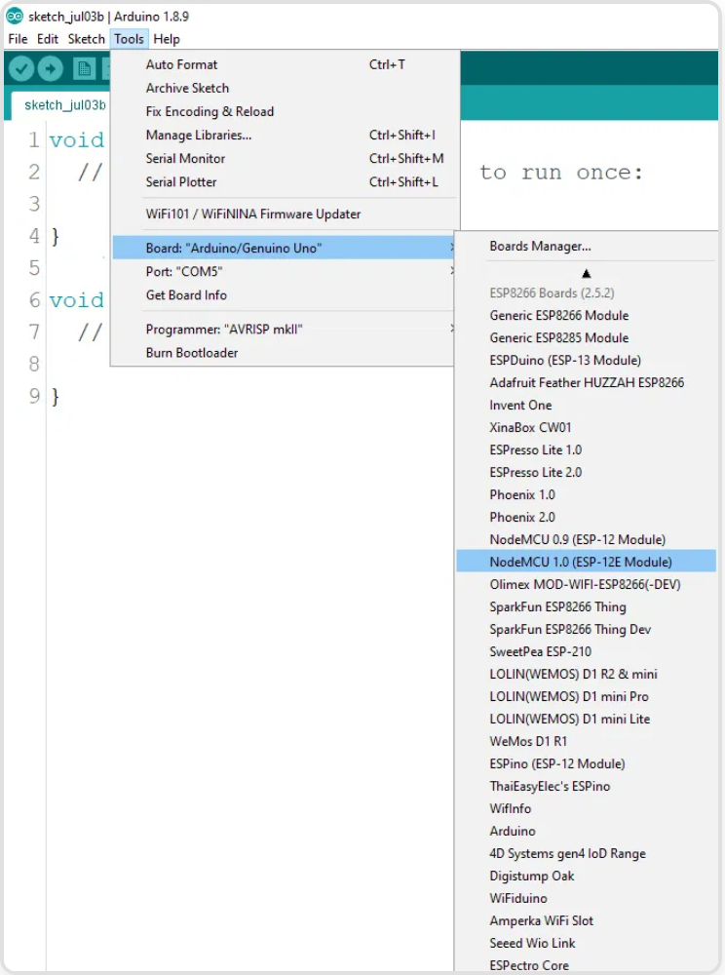
ESP8266 Board Support Setup
Adding ESP8266 Board Support
Required Libraries Installation
1
Open Arduino IDE Preferences
Go to
File > Preferences
in the Arduino IDE menu
2
Add Board Manager URL
In the "Additional Boards Manager URLs" field, paste:
http://arduino.esp8266.com/stable/package_esp8266com_index.json
3
Open Boards Manager
Go to
Tools > Board > Boards Manager...
4
Install ESP8266 Package
Search for "esp8266" and install the package by "ESP8266 Community"
ESP8266 Board Manager Installation
Libraries for Workshop:
5
Select NodeMCU Board
DHT Sensor Library
by Adafruit
After installation, go to
Tools > Board
and select
"NodeMCU 1.0 (ESP-12E Module)"
Adafruit GFX Library
(for OLED display)
To install libraries:
Adafruit SSD1306
(for OLED display)
Go to
Tools > Manage Libraries...
MQ135 by GeorgK
(for Gas Sensor)
Search for the library name
Adafruit Unified Sensor
(dependency)
Click "Install" (install dependencies if prompted)
Mpu6050 by Ewan Leng
(For gyroscope)

Slide 8

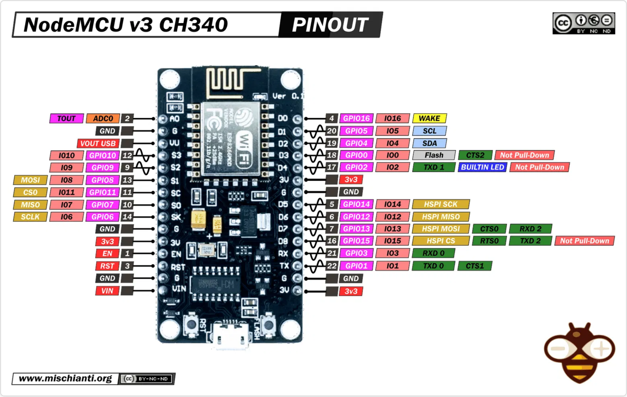




NodeMCU ESP8266 Introduction
What is NodeMCU ESP8266?
NodeMCU is an open-source IoT platform that includes firmware and development board based on the ESP8266 WiFi SoC from Espressif Systems.
NodeMCU Pinout
Key Features:
Built-in WiFi
802.11 b/g/n WiFi connectivity with TCP/IP stack
Powerful Processor
Tensilica L106 32-bit processor running at 80MHz
Memory
4MB Flash memory and ~50KB usable RAM
GPIO Pins
11 digital I/O pins with PWM, I2C, SPI, and ADC capabilities
Power
NodeMCU ESP8266 Pinout Diagram
USB powered (5V) with 3.3V operating voltage for I/O
Pin Types:
Cost-Effective
Low-cost development board perfect for IoT projects
D0-D8:
Digital I/O pins (GPIO pins)
A0:
Analog input (0-3.3V, 10-bit resolution)
Note:
3V3:
3.3V power output
For this workshop, we'll be using the NodeMCU 12E version, which is one of the most common variants available.
GND:
Ground pins
Vin:
External power input (5V)
RST:
Reset pin

Slide 9


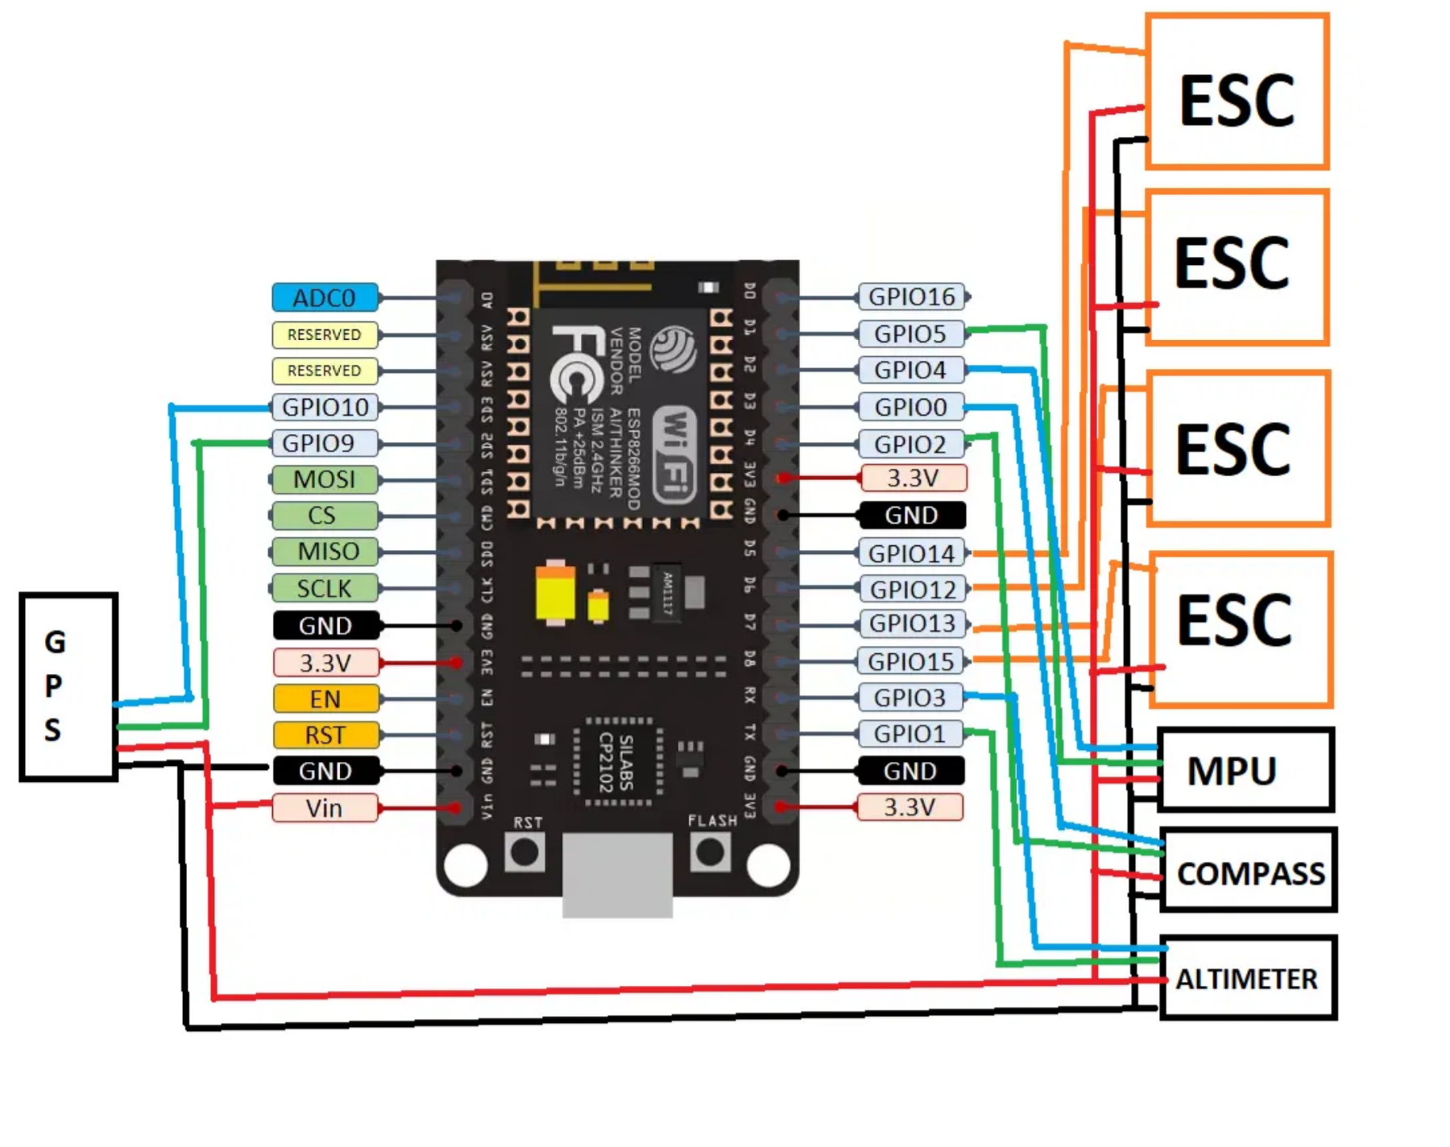



Physics-Relevant Sensors for ESP8266
Temperature & Humidity
DHT11/DHT22:
Temperature and humidity
Applications: Thermodynamics, heat transfer, phase changes
BME680:
Temperature, humidity, pressure, gas
Applications: Gas laws, atmospheric physics
Motion & Acceleration
MPU6050:
3-axis accelerometer and gyroscope
Applications: Kinematics, dynamics, rotational motion
HC-SR501:
PIR motion sensor
Applications: Event triggering, motion detection
Light & Optics
LDR:
Light dependent resistor
Applications: Light intensity, photodetectors
BH1750:
Digital ambient light sensor
Applications: Photometry, inverse square law
Sound & Force
ESP8266 Connected to Multiple Sensor Modules
KY-038:
Sound sensor
Applications: Acoustics, sound wave detection
Force Sensor:
Pressure/force detection
Applications: Hooke's Law, pressure measurement

Slide 10

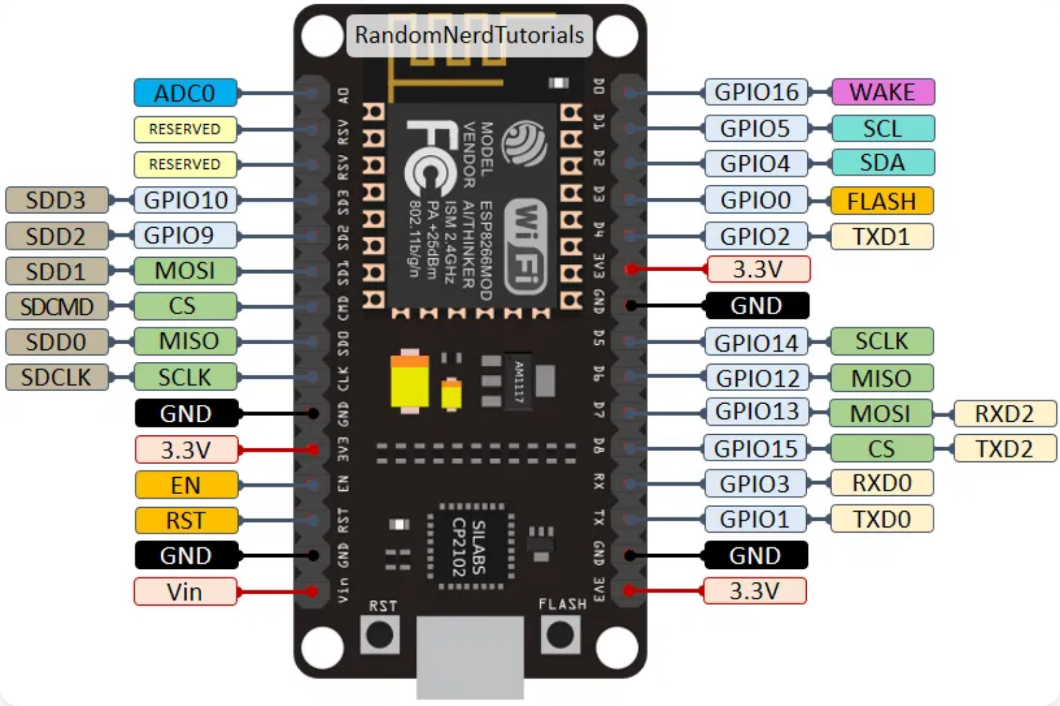
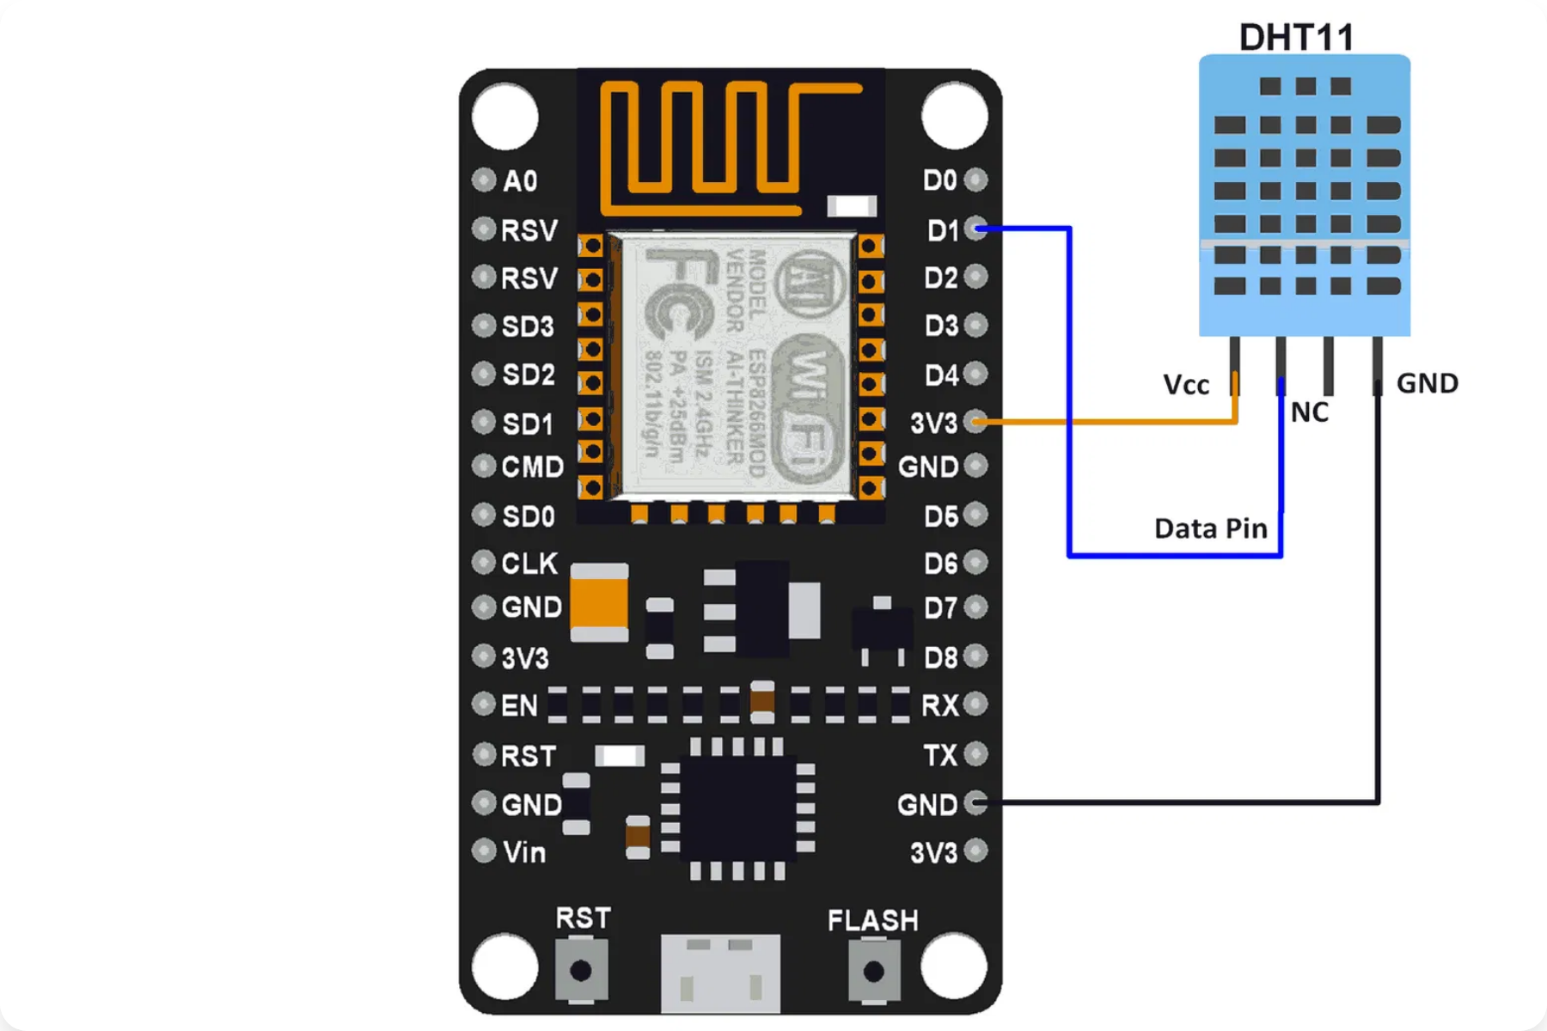
Sensor Connection Types
Digital Connections
• Uses GPIO pins (D0-D8 on NodeMCU)
• For ON/OFF or HIGH/LOW signals
• Examples: Push buttons, LEDs, relay modules
• Use
pinMode()
and
digitalWrite()/digitalRead()
Analog Connection
• ESP8266 has one analog input (A0)
ESP8266 NodeMCU Pinout Reference
• 10-bit resolution (0-1023 values)
• Examples: Potentiometers, light sensors
• Use
analogRead()
function
Communication Protocols
•
I2C
: For multiple sensors (SDA/SCL pins)
•
SPI
: Faster data transfer (MOSI/MISO/SCK)
•
UART
: Serial communication (TX/RX)
Example: DHT11 Temperature Sensor Connection
•
OneWire
: For temperature sensors like DS18B20

Slide 11

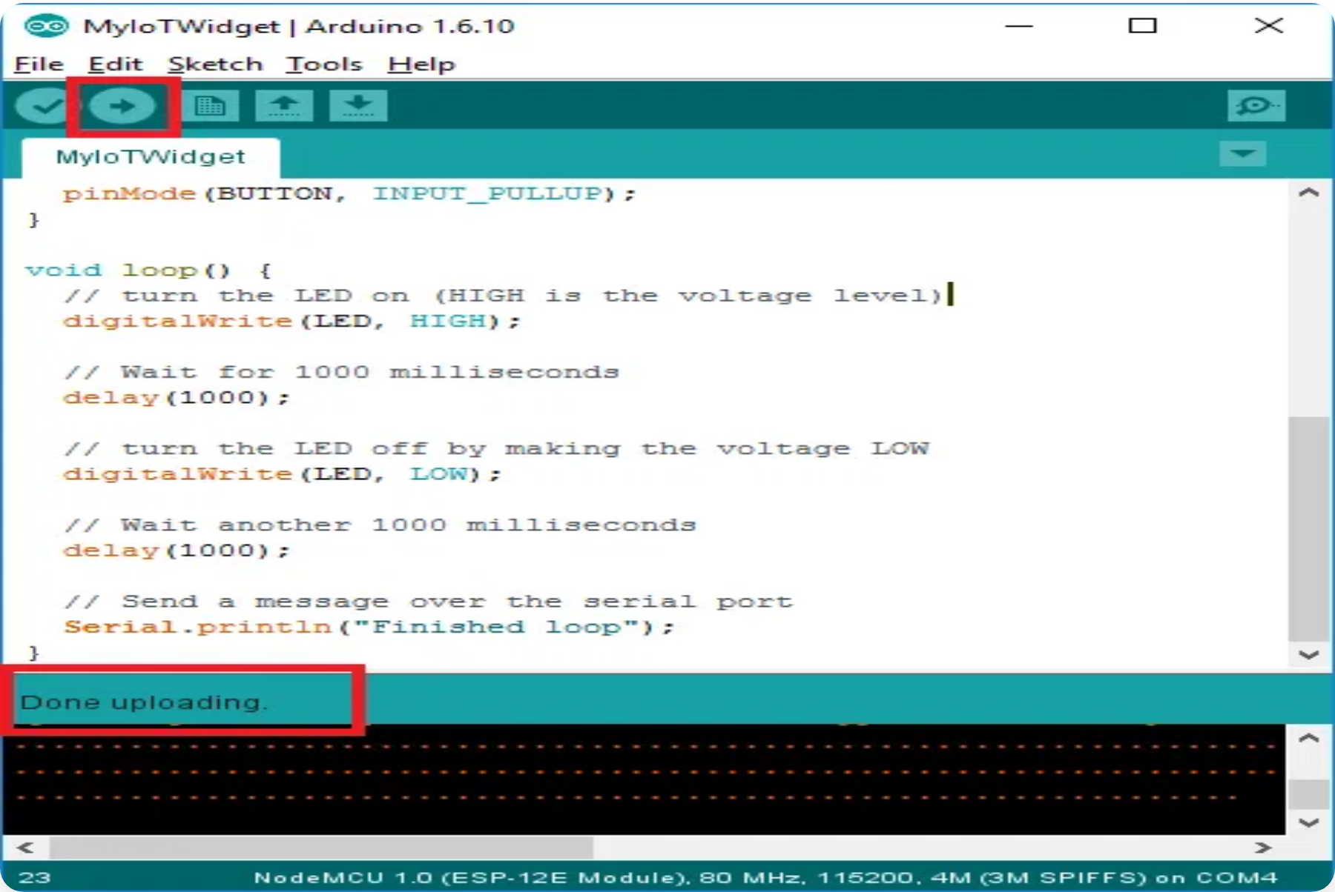
Basic Programming Concepts
Arduino Code Structure
•
setup()
function: Runs once at the start
Basic Code Example
•
loop()
function: Runs repeatedly
• Variable declarations at the top
// LED Blink Example
void setup() { pinMode(LED_BUILTIN,
• Custom functions as needed
OUTPUT);
// Set LED pin as output
} void loop() {
digitalWrite(LED_BUILTIN, HIGH);
// Turn LED on
delay(1000);
// Wait for 1 second
digitalWrite(LED_BUILTIN, LOW);
// Turn
Key Functions
LED off
delay(1000);
// Wait for 1 second
}
•
pinMode(pin, mode)
: Configures a pin as INPUT or
OUTPUT
•
digitalWrite(pin, value)
: Sets the pin HIGH or LOW
•
digitalRead(pin)
: Reads the value from a pin
•
delay(ms)
: Pauses the program for specified time
Uploading and Testing
• Click the upload button (right arrow icon)
• Wait for code to compile and upload
• Check the Serial Monitor for debugging
• Observe the board and connected components
Arduino IDE Interface with ESP8266 Code

Slide 12



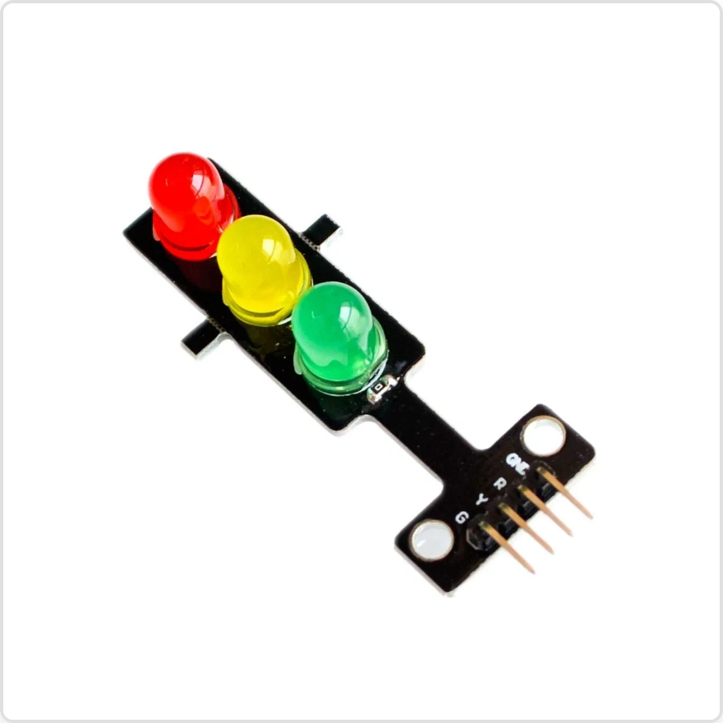
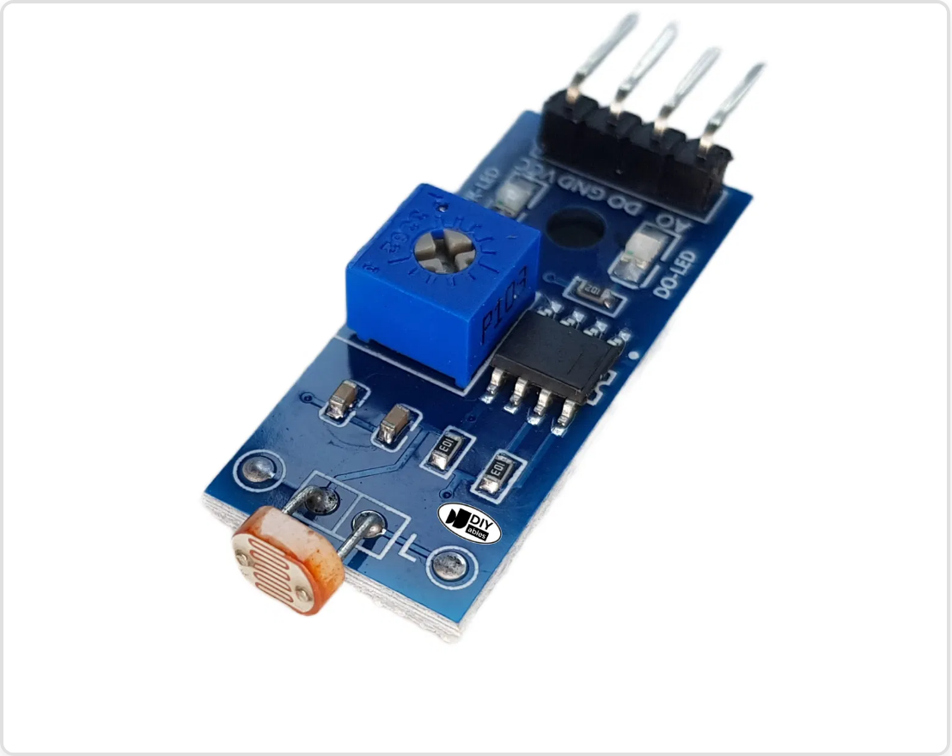
Experiments 1-2: LED Traffic Light & Light Sensor
Experiment 1: The "Hello, World!" of Hardware
Experiment 2: Sensing the Light
Objective:
Learn the basics of Arduino IDE, upload your first program,
Objective:
Read an analog signal from the LDR (Light Dependent
and control a digital output.
Resistor) module to measure ambient light levels.
Components:
Components:
NodeMcu ESP8266
NodeMcu ESP8266
LED Traffic Lights Signal Module
LDR Light Sensor Module
Male to Female Jumper Wires (3x)
Male to Female Jumper Wires (3x)
Micro USB Cable
Connections:
Connections:
LED Traffic Light Module
LDR Light Sensor Module
LDR Module Pin
NodeMCU Pin
Traffic Light Module Pin
NodeMCU Pin
A0 (Analog)
A0
G (Green LED)
D1 (GPIO5)
VCC / +
3V3
Y (Yellow LED)
D2 (GPIO4)
GND
GND
R (Red LED)
D3 (GPIO0)
GND
GND
Expected Outcome:
The Serial Monitor will display light level readings. Cover the LDR with your hand to see the value increase (indicating darkness). Shine a light on it to see the value decrease.

Slide 13

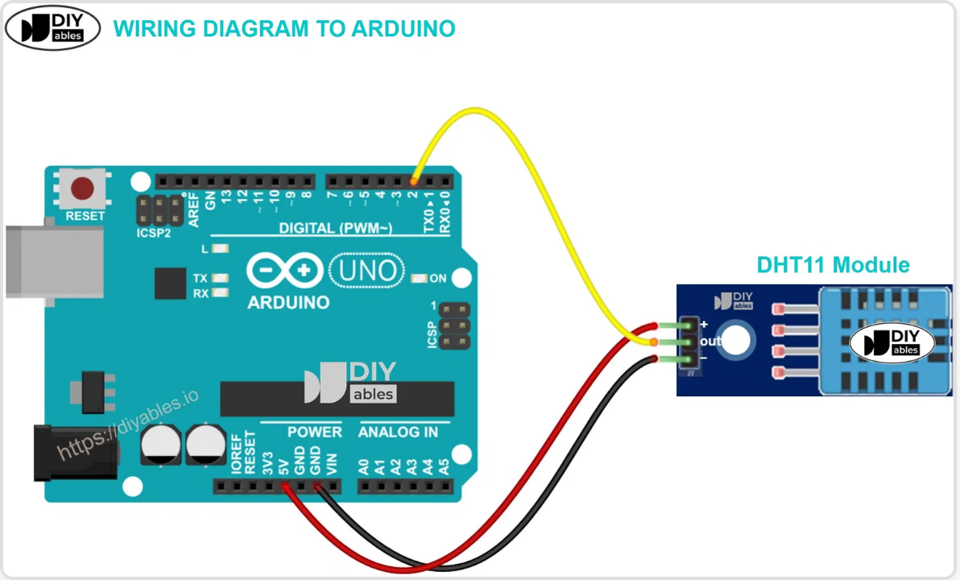
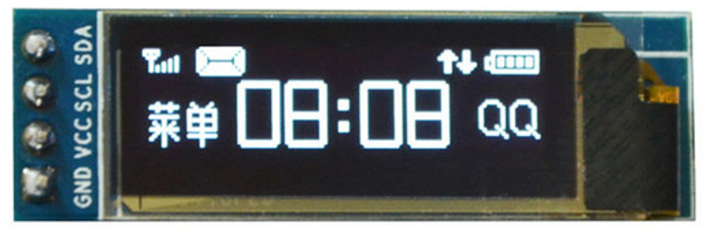

Experiments 3-4: DHT11 & OLED Display
Experiment 3: The Digital Weather Station
Experiment 4: Information at a Glance
Objective:
Objective:
Read temperature and humidity data from the DHT11 sensor
Display sensor data on an OLED screen to create a standalone device
DHT11 Temperature & Humidity Sensor Module
0.91 inch I2C OLED Display
Required Library:
Connections:
Required Libraries:
Connections (I2C):
DHT sensor library
by
DHT11 Pin
NodeMCU Pin
Adafruit GFX Library
Component
NodeMCU Pin
Adafruit
DATA / OUT
D4 (GPIO2)
Adafruit SSD1306
OLED SCL/SCK
D1 (GPIO5)
VCC
3V3
OLED SDA
D2 (GPIO4)
GND
GND
OLED VCC
3V3
OLED GND
GND

Slide 14

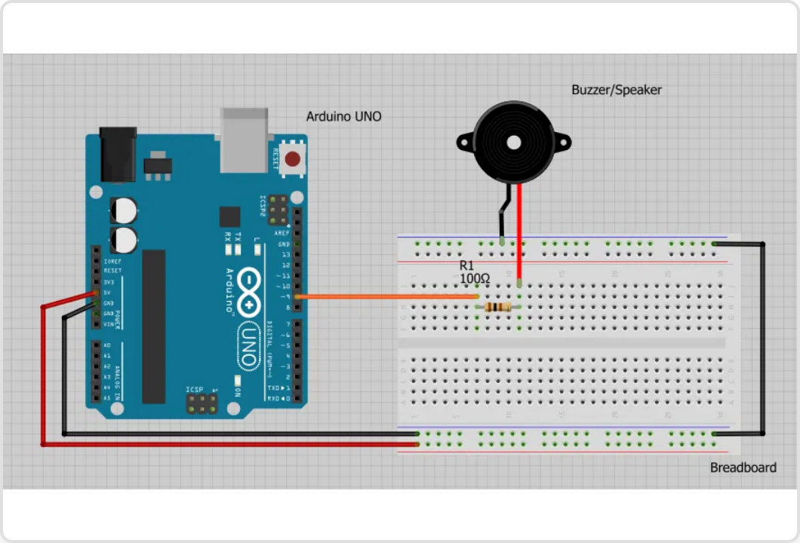
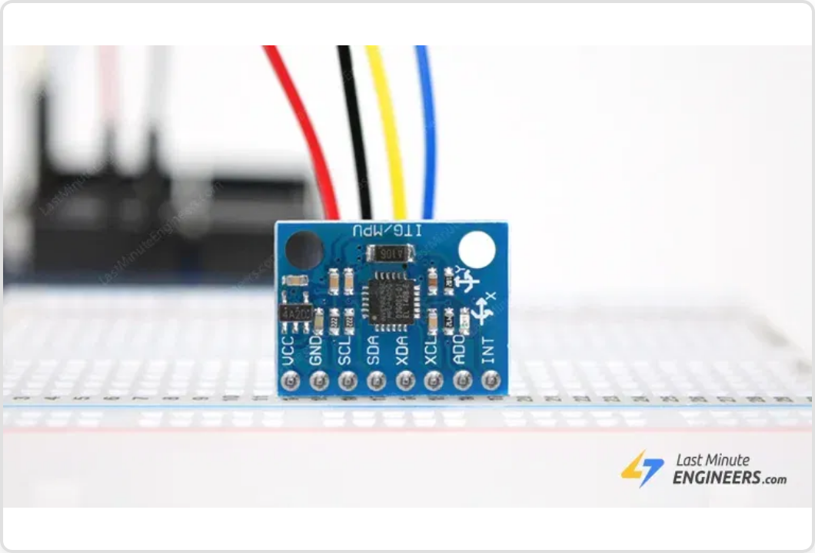
Experiments 5-6: Buzzer & MPU-6050
Experiment 5: Creating Alerts
Experiment 6: Shake, Rattle, and Roll
Objective:
Objective:
Use the Piezo Buzzer to create an audible alert when temperature exceeds a threshold
Interface with the MPU-6050, a 3-axis accelerometer and 3-axis gyroscope sensor
Connections:
Required Libraries:
Component
NodeMCU Pin
Adafruit MPU6050
DHT11 DATA
D4 (GPIO2)
Piezo Buzzer Module
Adafruit Unified Sensor
MPU-6050 Gyroscope/Accelerometer
Buzzer +
D5 (GPIO14)
Connections:
Expected Outcome:
Buzzer -
GND
MPU-6050
NodeMCU
The Serial Monitor will display acceleration (m/s²) and gyroscope (rad/s) values for all three axes (X, Y, Z). When you tilt or move the sensor, you'll see the values change dramatically.
VCC
3V3
GND
GND
SCL
D1 (GPIO5)
SDA
D2 (GPIO4)

Slide 15
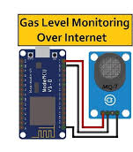
Experiments 7: Air Quality Monitoring
Experiment 7: Air Quality
Objective:
To detect a wide range of gases, making it ideal for air quality monitoring.
Connections:
Component
NodeMCU Pin
A0
A0
Gas Sensor Module
VCC
3V3
GND
GND

Slide 16

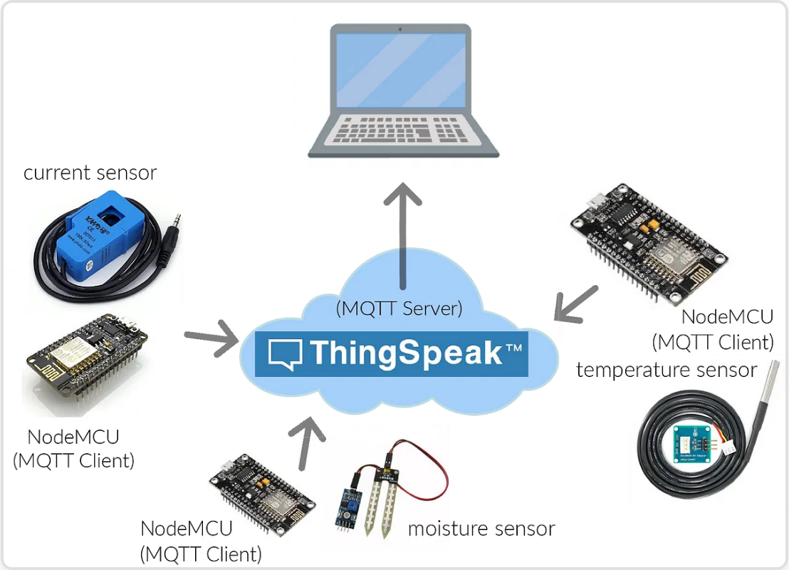
Experiment 8: Your First IoT Project
Connecting to the Internet
Code Implementation
Objective:
Required Libraries:
Connect your device to the Internet and send temperature and humidity data to ThingSpeak.
ESP8266WiFi (included with ESP8266 board support)
DHT sensor library (from previous experiments)
ThingSpeak Setup:
1
Expected Outcome:
Create a ThingSpeak Account
The NodeMCU will connect to WiFi and upload temperature and humidity data to ThingSpeak every 20 seconds. You can view real-time graphs on the ThingSpeak website.
Sign up at
ThingSpeak.com
2
Create a New Channel
Click on "Channels" → "New Channel"
3
Configure Fields
Enable "Field 1" (Temperature) and "Field 2" (Humidity)
4
Get API Key
Go to "API Keys" tab and note your "Write API Key"
ThingSpeak IoT Analytics Platform

Slide 17
Experiment 9: Save the Data to Google Sheet
Go to sheets.new to create a new spreadsheet.
Set up your columns in the first row. For example:
A1: Timestamp
B1: Temperature (C)
C1: Humidity (%)
// This function runs when the web app URL receives an HTTP GET request.
function doGet(e) {
// Get the active spreadsheet and the specific sheet named "Sheet1".
var ss = SpreadsheetApp.getActiveSpreadsheet();
var sheet = ss.getSheetByName("Sheet1");
// Get the temperature and humidity values from the URL parameters.
// Example URL: .../exec?temp=25.5&hum=45.2
var temperature = e.parameter.temp;
var humidity = e.parameter.hum;
// Create a new Date object for the timestamp.
var timestamp = new Date();
// Add a new row to the sheet with the collected data.
sheet.appendRow([timestamp, temperature, humidity]);
// Return a success message.
return ContentService.createTextOutput("Data received successfully.");
}
Create the Google Apps Script
In your new sheet, go to Extensions → Apps Script.
Delete any placeholder code in the Code.gs window and paste the following code:
Click the Save project icon (💾). Give your project a name when prompted (e.g., "Sensor Data Logger").

Slide 18
Deploy the Script as a Web App
This is the most important step.
Click the blue Deploy button in the top-right corner and select New deployment.
Click the gear icon (⚙️) next to "Select type" and choose Web app.
Under "Configuration", fill in the details:
Description: "NodeMCU Sensor Data" (optional).
Execute as: Me (your Google account).
Who has access: Anyone. This is critical for the NodeMCU to be able to send data without needing to log in.
Click Deploy.
Google will ask you to Authorize access. Click the button, choose your Google account, click "Advanced", and then "Go to [Your Project Name] (unsafe)". Allow the permissions.
After authorizing, a new window will appear with your Web app URL. Copy this URL. It will look like https://script.google.com/macros/s/LONG_RANDOM_ID/exec

Slide 19
Experiment 10: Create a Website to Display the Data
Publish Your Google Sheet to the Web
Open your Google Sheet.
Go to the menu and click File → Share → Publish to web.
In the new window, under the "Link" tab:
In the first dropdown, select the specific sheet that has your data (e.g., Sheet1).
In the second dropdown, select Comma-separated values (.csv).
Click the green Publish button. Confirm that you want to publish.
A box will appear with a URL. Copy this URL. This is the link your HTML page will use to read the data.

Slide 20
Experiment 10: Create a Website to Display the Data
this is a link to a google csv file. there may be date alone and values missing. In this the data will be updated automatically from an iot device. you need to create a html page to parse the csv data using a script to display the live data last 30 values and a dashboard of current data using a script. create a single html. https://docs.google.com/spreadsheets/d/e/2PACX-1vSCgq-zgskunwfCvm9ABxto7a2lja8iSkd-N4Ah0Ukif6jbTUVlCCusS/pub?gid=0&single=true&output=csv
https://onecompiler.com/

Slide 21

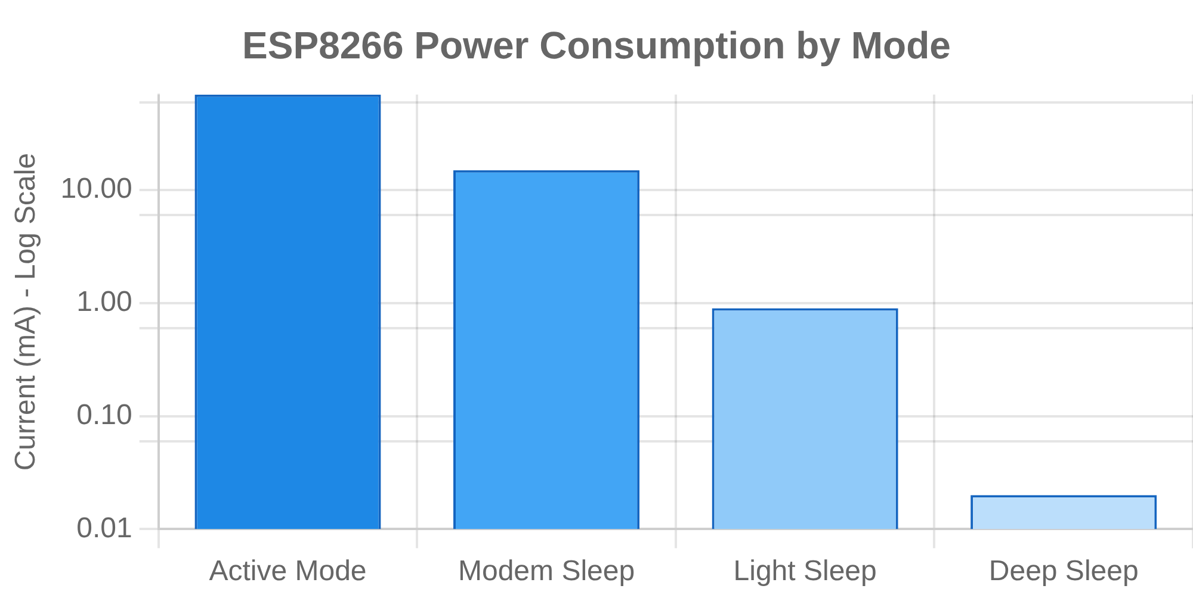




Advanced Concepts and Project Ideas
Advanced ESP8266 Techniques
Power Management
Deep sleep mode can reduce power consumption from ~70mA to ~20μA, extending battery life from days to months
OTA (Over-The-Air) Updates
Update firmware wirelessly without physical connection to the device
Implementation Tips
Start with simple projects and gradually add complexity
Use libraries when available to simplify development
Web Server Implementation
Document your code thoroughly for future reference
Create a local web interface for controlling experiments and viewing data
Consider creating a custom PCB for permanent installations
Implement error handling for robust operation
Data Logging to SD Card
Store large datasets locally for later analysis
Magnetic Field Mapper
: Create a 3D visualization of magnetic field
Physics Project Ideas
strength using Hall effect sensors
Pendulum Period Measurement
: Use MPU6050 to precisely measure
Environmental Physics Monitor
: Track temperature, pressure, humidity
oscillation period and analyze damping effects
changes and correlate with physical phenomena

Slide 22

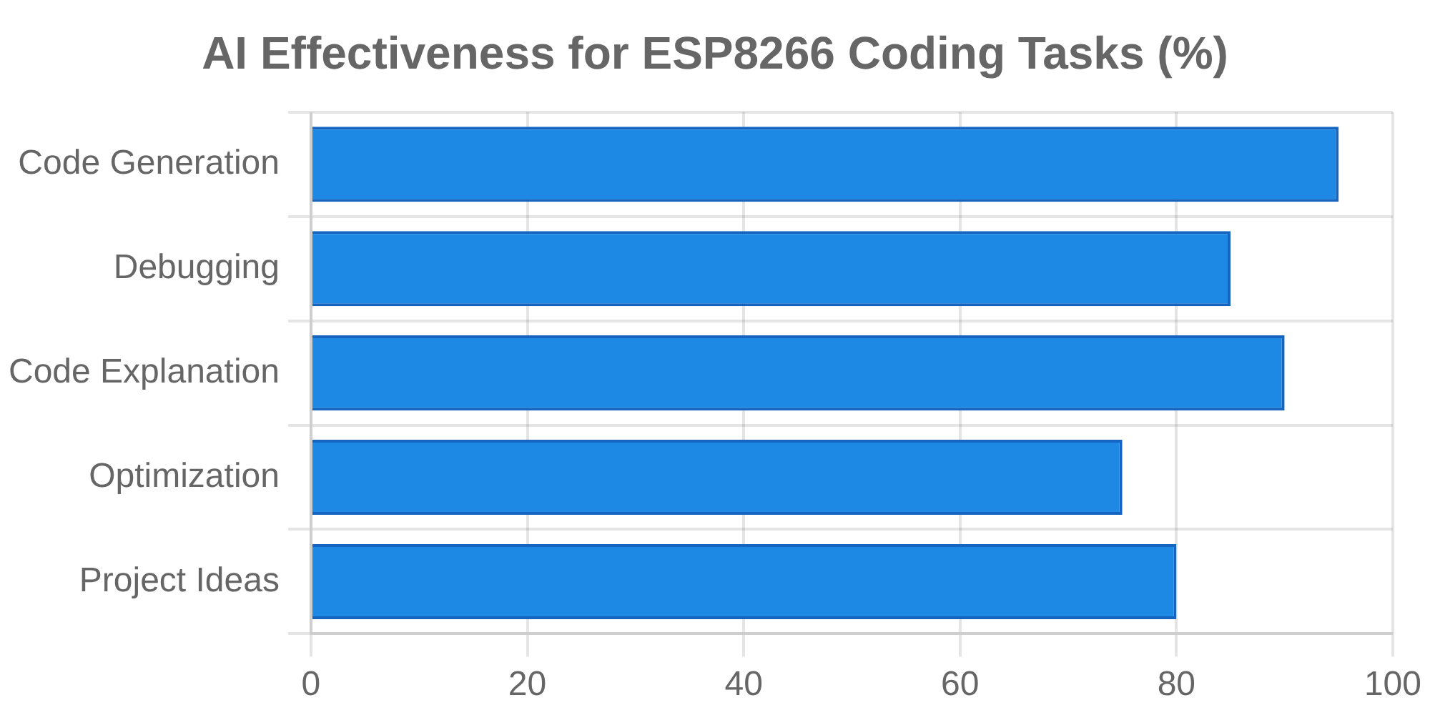



AI-Assisted Coding for ESP8266
How AI Can Help You Code
Generate Code Snippets
Provide natural language descriptions to get working code examples
Debug and Troubleshoot
Paste error messages to get solutions and explanations
Explain Code
Understand unfamiliar code or complex functions
Optimize and Refactor
Improve efficiency and readability of your code
Example Prompts
"Generate Arduino code for ESP8266 to read temperature from DHT11 sensor and print to serial monitor"
Best Practices
Be specific in your prompts
Iterate and refine your requests
"How can I calculate tilt angle from accelerometer readings (a.acceleration.x, y, z)?"
Understand the code, don't just copy
Verify information with official documentation
Provide context when debugging

Slide 23

Thank You
Questions / Feed back

